Slide 1

Knowvation - AI Hiring Intelligence Platform
Python Full Stack Development Project Submission Presented By: Lingala Bishma Goud
Domain: Python Full Stack Development

Slide 2
Project Overview-What is Knowvation?
A full-stack AI-driven hiring intelligence web application.
Automates the extraction and analysis of job market trends.
Scrapes raw job data and uses Google Gemini AI for structured NLP analysis.
Provides recruiters with a dynamic 3D-inspired analytics dashboard.

Slide 3
Problem Statement - The Problem We Are Solving
Manual collection of job market data is slow and inefficient.
Hard to track competitor hiring trends in real-time.
Identifying highly demanded skills requires reading hundreds of descriptions.
Solution: An automated scraper + AI analysis pipeline to generate instant insights.

Slide 4
Technology Stack
Frontend: Next.js, React, TailwindCSS, Recharts, Framer Motion
Backend: Python, FastAPI
Web Scraping: Playwright
AI Engine: Google Gemini API
Database & Auth: Appwrite

Slide 5
System Architecture: How It Works

Slide 6
System Architecture: How It Works
Flow: Frontend Client <-> FastAPI Backend <-> Appwrite Database
The backend triggers Playwright to scrape external job boards.
Scraped text is fed into the Gemini API.
The AI returns structured data (skills, trends) which is saved in Appwrite.
The frontend fetches this data to display interactive Recharts.

Slide 7
Key Features - Implemented
Secure User Authentication (Appwrite).
Automated Web Scraping (Playwright).
AI Job Description Analysis (Gemini).
Interactive Analytics Dashboard (Recharts/Chart.js).
Recruiter Intelligence Directory (HR Contact extraction).
Report Generation (CSV/Excel exports).

Slide 8
AI Data Extraction
Input: Unstructured, messy job description text.
Processing: Prompt engineering with Gemini API.
Output: Standardized JSON format.
Extracted Fields: Role, Required Skills, Experience Level, Hiring Trend (Aggressive/Steady/Freeze), AI Confidence Score.

Slide 9
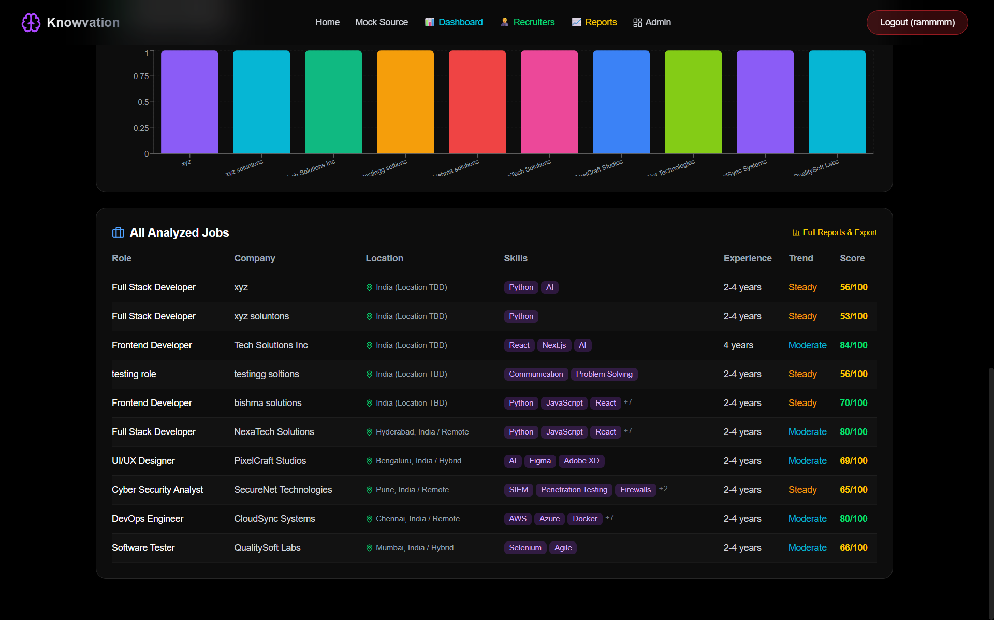
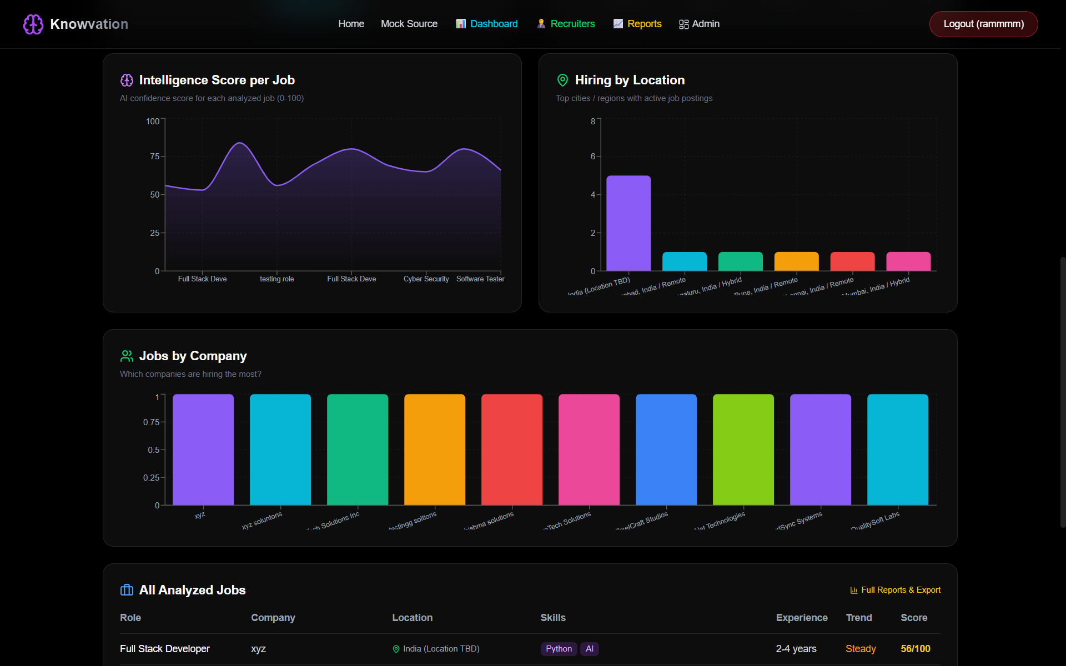
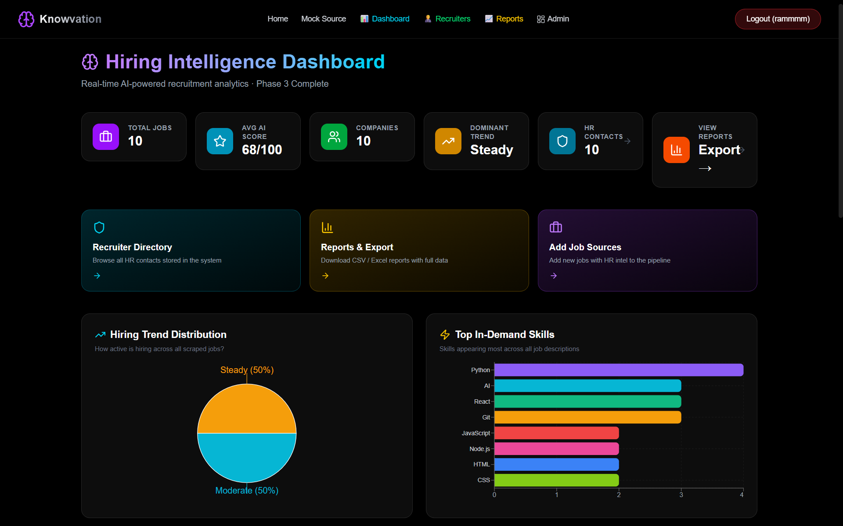
Demo & Screenshots

Slide 10
Conclusion & Future Scope
Successfully built a scalable Python Full Stack application integrating Agentic AI.
Future Scope: Add real-time LinkedIn/Indeed scraping, implement email outreach automation for recruiters, and add predictive hiring algorithms.

Slide 11

Thank You!
GitHub Link:- https://github.com/lingalabishmagoud/Knowvation-
Email:- bishmagoud321@gmail.com

